Slide 1
History of Education – St Mark and St John
Dave Harris
dharris@marjon.ac.uk
http://www.arasite.org/

Slide 2
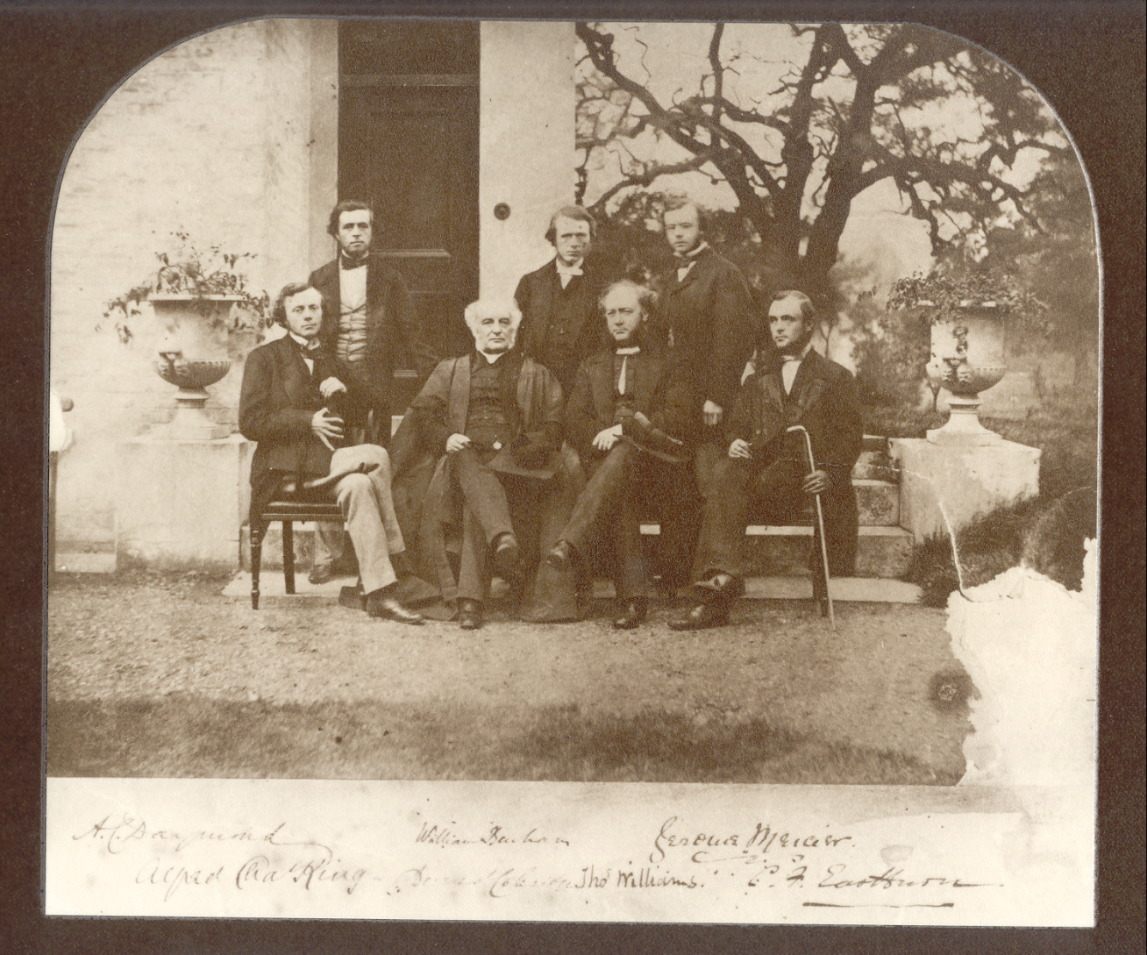
Derwent Coleridge 1800--1883

Slide 3
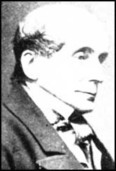
James Kay-Shuttleworth 1804-- 1877

Slide 4
Educational Ideas
Both committed to reforming school system and training suitable teachers for them
Schools to be humane, no corporal punishment, sympathetic
Great interest in Continental teaching methods, especially Pestalozzi
Mixed teaching, including ‘the object lesson’

Slide 5
The real object lesson
Not Dickens’ parody
Work with objects not books
Invite class to reflect on the qualities of objects, leading them towards more complex understandings
Example from the Journal of Education 1847 (Marjon archive)

Slide 6
School discipline
Paupers likely to be degraded and ‘brutish’, as well as verminous, starving and ragged
No help likely from parents or other adults in the neighbourhood
Only hope – constant surveillance, intervention, endless patience and ‘persuasive manner’, appeal to moral and religious feelings, conscience and long term consequences

Slide 7
Training College discipline
Same problems, same solution
Scholars lived in, constant surveillance included supervision of their reading material
Punishing regime that began at 5.30am and ended at 10pm. Combination of manual labour (industrial or gardening) and substantial instruction.
Testing and certification – try the 1846 exam paper for St Mark’s students?

Slide 8
1846 exam paper
SECTION I. 1.—In what respects does the world appear to have been prepared for the Advent of the promised Messiah?
2. Account for the general rejection of the Messiah by the Jewish nation.
3. What two fundamental propositions in respect to the propagation of the gospel, has Paley established in his " Treatise on the Evidences of Christianity"?

Slide 9
The Political Struggle for Schooling and Teacher Professionalism
Substantial conflict between CofE, nonconformists, Parliamentary politicians.
Worries included inefficiency and cost -- and schooling upsetting the social order
20 years careful compromise and persuasion from both Principals to equip teachers with reasonable pay and pensions and equip schools
Standards raised by Inspectorate (established by Kay-Shuttleworth)
Curriculum at St Mark’s to include Latin and choral services

Slide 10
End of an Era
The Revised Code of 1862
Focus on ‘Three Rs’ and vocational training
‘Payment by results’ (attendance and test performance)
Principals’ predictions – cuts in resources, narrowing of curriculum, ‘teaching to the test’

